Slide 1
CICAT Analysis of AP1000 Safety Systems
Jackson Wynn Samuel McCracken
May 2020

Slide 2
BLUF
Critical Infrastructure Cyberspace Analysis Tool (CICAT) automates the generation of cyber attack scenarios for critical infrastructure
An infrastructure model was developed based on open source data and used to generate scenarios for AP1000 safety systems
This brief discusses:
CICAT
the AP1000 infrastructure model
scenario scoping considerations
results, and
lessons learned
2

Slide 3
Critical Infrastructure Cyberspace Analysis Tool (CICAT)
CICAT is a decision support tool originally developed for cyber incident analysis and response planning at nuclear facilities
IAEA Collaborative Research Program (CRP) J02008
CICAT provides a modeling and simulation capability that includes automated generation of cyber attack scenarios
A cyber attack scenario is defined as a targeted attack by a known adversary
CICAT-generated scenario results incorporate open source ATT&CK® and CVE® data
CICAT produces scenarios for an infrastructure model representing enterprise capabilities, functions, systems, components, and network connections
CRP J02008: We use an IAEA developed reference architecture of a pressurized water reactor (PWR) called Asherah
CICAT can be easily adapted for use with other critical infrastructures and/or cyber physical systems
3

Slide 4
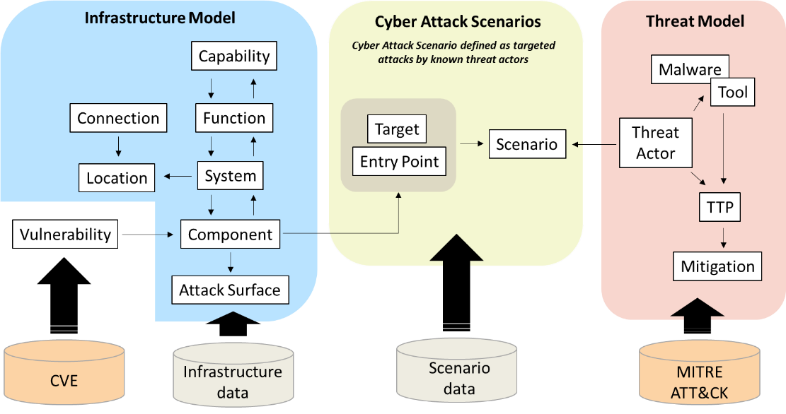
CICAT Data Model
Imported as XML data
Imported from STIX/TAXII service
http://cve.mitre.org/
https://attack.mitre.org/

Slide 5
Scenario Generation
CICAT scenario generation is a 2-step process
Attack Path Analysis: Identifies path(s) through the infrastructure between an entry point and the scenario target
Target access evaluated over multiple entry points
Dijkstra algorithm used to identify shortest path without cycles
Components selected for attack path based on analytics
Technique Filtering: Selects ATT&CK techniques for components on attack path
Techniques selected based on adversary objectives, platforms, and threat actor capabilities
Tactic Patterns represent sequences of adversary objectives mapped to ATT&CK tactics
Adversary objectives based on ODNI Cyber Threat Framework*
*https://www.dni.gov/index.php/cyber-threat-framework
5

Slide 6
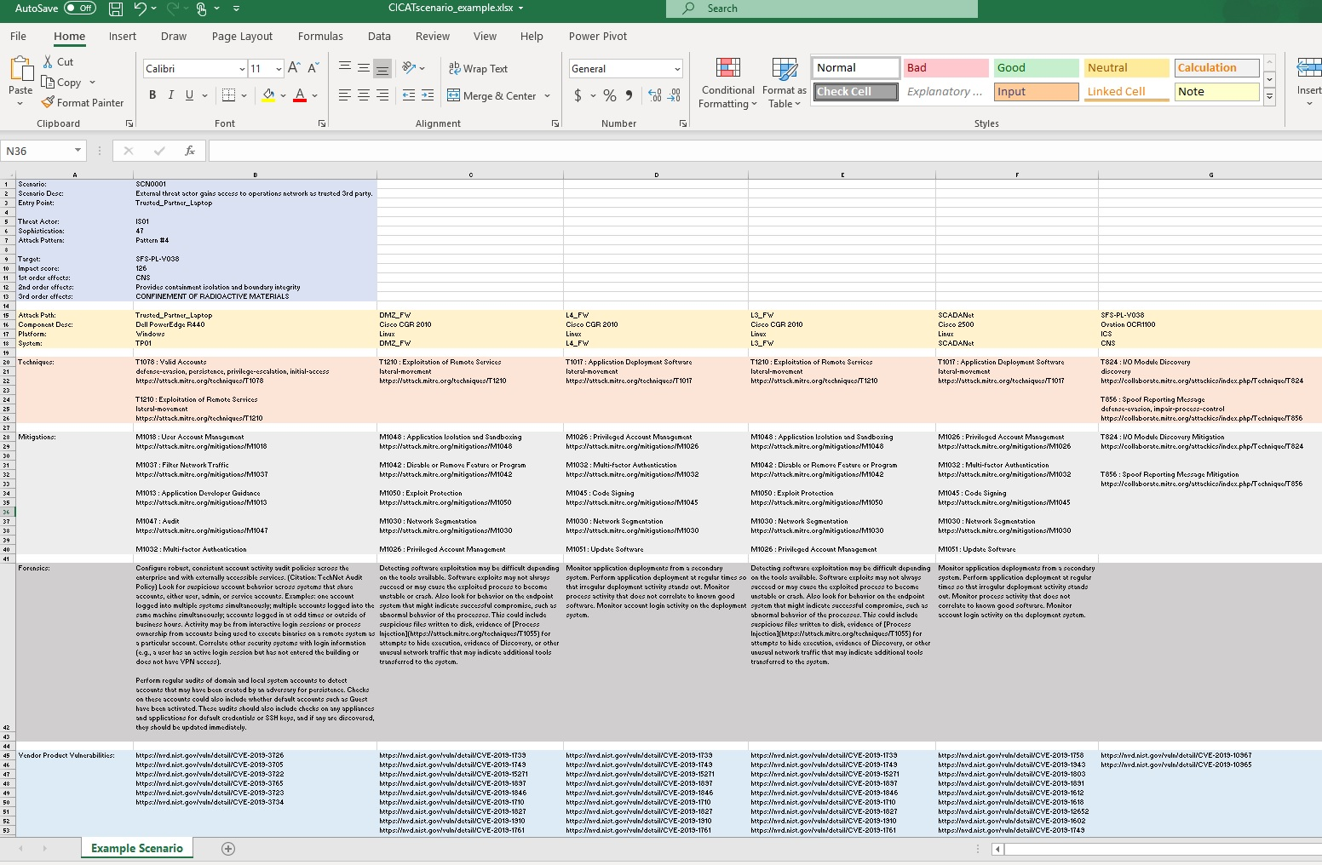
CICAT-Generated Scenario Results
Entry Point
Threat Actor
Scenario Details
Target
Effects
Attack Path Details
ATT&CK Techniques
ATT&CK Mitigations
ATT&CK Detection
Related CVE URLs
6

Slide 7
Scenario Scoping Considerations
Scenario scope is defined by the target and entry point(s) used to gain access, as well as the threat actor, tactics, and techniques used
CICAT can be used to evaluate multiple scenarios concurrently, each targeting a different component
All scenarios use the same set of entry points
SCENARIO ID | DESCRIPTION | ACTOR | TACTIC PATTERN | TARGET
SCN0001 | Perform reconnaissance and install backdoor | IS01 | Old Lady | SFS-PL-V038
SCN0002 | Perform reconnaissance and disruptive strike | IS01 | Bunny Ear | VES-PL-V005A
SCN0003 | Lateral movement and backdoor inject | IS01 | Easter | PXS-PL-V118A
SCN0004 | Lateral movement, collection, and exfil | IS01 | Moon | DAS-Processor
ID | ASSET NAME | SYSTEM NAME | ENTRY POINT
OCS03 | OCS03 | OCS | X
EX002 | Trusted_Partner_Laptop | TP01 | X
NT007 | Corporate_User_Laptop | CP01 | X
7

Slide 8
Scenario Threat Actors
ATT&CK includes info on threat actors and the range of ATT&CK techniques, malware, and cyber tools they are attributed to using
ATT&CK includes details on 95+ threat actors, e.g., APT28, Dragonfly, OilRig, etc. (https://attack.mitre.org/groups/)
CICAT v1.1 also supports a threat actor profile capability used to define hypothetical threat actors and assign specific ATT&CK techniques
Threat actor profiles support comparative analysis of threat actor capabilities, predictive analysis of evolving threat actors, etc.
Depending on tactics and capabilities, different threat actors can produce significantly different scenarios over the same attack path
8

Slide 9
AP1000 Analysis

Slide 10
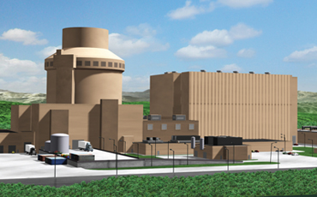
AP1000 Pressurized Water Reactor (PWR)
Designed by Westinghouse Electric Co.
1000 MWe (3415 MWt) Nuclear Power Plant
Pressurized water reactor
Passive safety features
Certified by NRC in 2005
2 under construction in the U.S. (2 cancelled)
https://www.westinghousenuclear.com/new-plants/ap1000-pwr
10

Slide 11

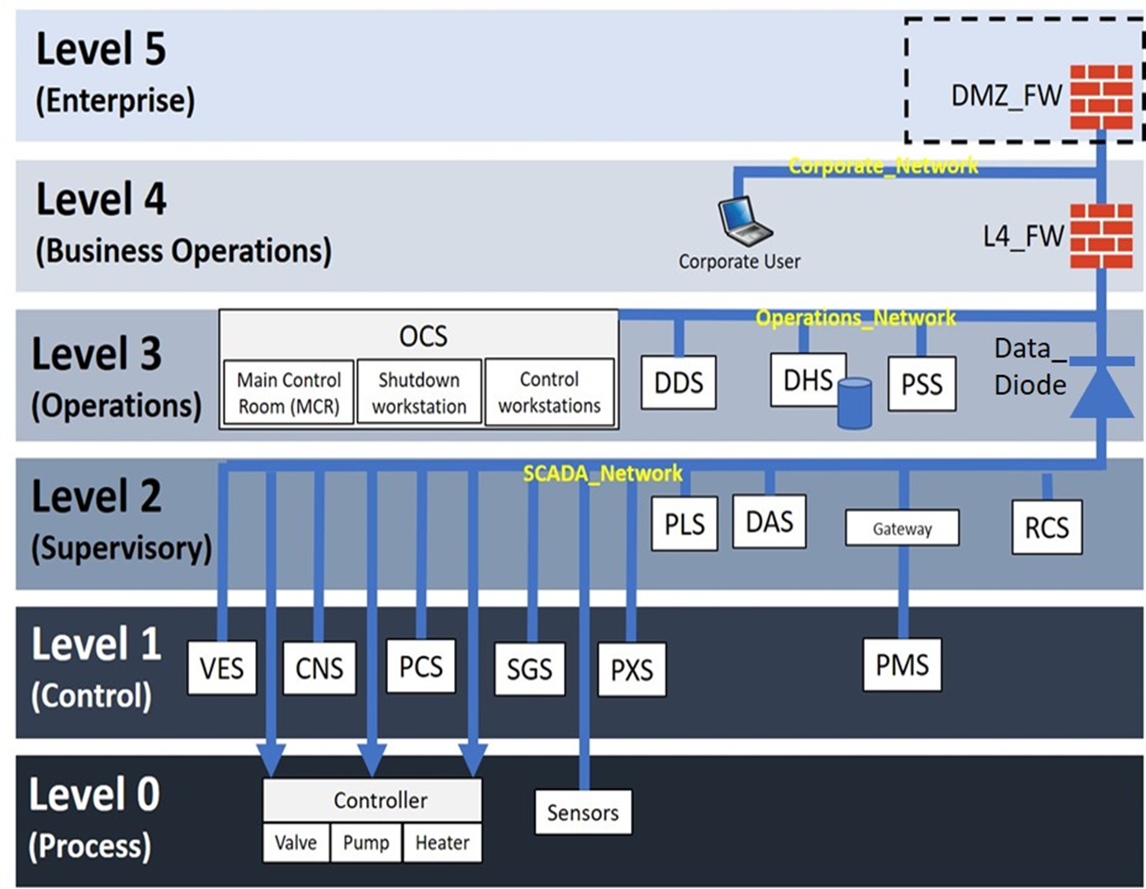
Modeled Target Environment
Trusted Partner Laptop
Internet
Modeled Systems |  | Safety System | I&C
CNS | Containment System | X
PCS | Passive Containment Cooling System | X
PMS | Protection and Safety Monitoring System | X
PXS | Passive Core Cooling System | X
SGS | Steam Generator System | X
VES | Main Control Room Emergency Habitability System | X
DAS | Diverse Actuation system | X
PLS | Plant Control System | X
RCS | Reactor Coolant System | X
DDS | Data Display and Processing System |  | X
DHS | Data Historian System |  | X
OCS | Operation and Control Centers System |  | X
PSS | Physical Security System
11

Slide 12
AP1000 Scenario Scope Targets and Entry Points
Targets
System | Component | Description
CNS | SFS-PL-V038 | Controller for SFS Discharge Line Containment Isolation MOV – ORC
VES | VES-PL-V005A | Controller for MCR Air Delivery Isolation Valve A
DAS | DAS-Processor | Processor hosting DAS control logic: automatic reactor trip
PXS | PXS-PL-V118A | Controller for Containment Recirculation A Squib Valve
Entry Points
Entry Point | Description | Location
OCS03_Workstation | Local Control Station 1 | Level 3
Corporate_User_Laptop | Business Analytics Laptop | Level 4
Trusted_Partner_Laptop | External Equipment Supplier laptop | Remote

Slide 13
AP1000 Scenario Scope Threat Actor IS01 Tactics and Techniques
Tactic | Technique | Platform
Initial Access | T1133 External Remote Services | Windows
 | T1190 Exploit Public Facing Application | Windows, Linux
 | T1078 Valid Accounts | Windows, Linux
 | T860 Wireless Compromise | ICS
 | T847 Replication Through Removable Media | ICS
Execution | T1059 Command-line Interface | Window, Linux
 | T1203 Exploitation of Client Execution | Windows, Linux
 | T875 Change Program State | ICS
 | T830 Man in the Middle | ICS
Persistence | T1098 Account Manipulation | Windows, Linux
 | T1109 Component Firmware | Windows
 | T1136 Create Account | Windows, Linux
 | T1158 Hidden Files and Directories | Windows, Linux
 | T857 System Firmware | ICS
 | T873 Project File Infection | ICS
Privilege Escalation | T1068 Exploitation of Privilege Escalation | Windows, Linux
 | T1055 Process Injection | Windows, Linux
 | T1058 Service Registry Permissions Weakness | Windows
Defense Evasion | T1146 Clear Command History | Linux
 | T1089 Disabling Security Tools | Windows, Linux
 | T1222 File and Directory Permissions Modification | Windows, Linux
 | T820 Exploitation for Evasion | ICS
 | T848 Rogue Master Device | ICS
Credential Access | T1003 Credential Dumping | Window, Linux
 | T1214 Credentials in Registry | Windows
 | T1056 Input Capture | Windows, Linux
Discovery | T1087 Account Discovery | Window, Linux
 | T1083 File and Directory Discovery | Windows, Linux
 | T1046 Network Service Scanning | Window, Linux
Tactic | Technique | Platform
 | T824 I/O Module Discovery | ICS
Lateral Movement | T1017 Application Deployment Software | Window, Linux
 | T1210 Exploitation of Remote Services | Windows, Linux
 | T1076 Remote Desktop Protocol | Windows
 | T812 Default Credentials | ICS
Collection | T1119 Automated Collection | Window, Linux
 | T1005 Data from Local System | Windows, Linux
 | T1114 Email Collection | Windows
 | T1074 Data Staged | Window, Linux
 | T877 I/O Image | ICS
 | T801 Monitor Process State | ICS
Command and Control | T1043 Commonly Used Port | Windows, Linux
 | T1090 Connection Proxy | Windows, Linux
 | T1205 Port Knocking | Linux
Exfiltration | T1011 Exfiltration Over Other Network Medium | Windows, Linux
 | T1020 Automated Exfiltration | Windows, Linux
 | T1048 Exfiltration Over Alternative Protocol | Windows, Linux
Impact | T1485 Data Destruction | Windows, Linux
 | T1499 Endpoint Denial of Service | Windows, Linux
 | T1492 Stored Data Manipulation | Windows, Linux
 | T1529 System Shutdown/Reboot | Windows, Linux
 | T827 Loss of Control | Windows, Linux
 | T826 Loss of Availability | ICS
 | T880 Loss of Safety | ICS
Inhibit Response Function | T833 Modify Control Logic | ICS
 | T816 Device Restart/Shutdown | ICS
 | T803 Block Command Message | ICS
Impair Process Control | T855 Unauthorized Command Message | ICS
 | T875 Change Program State | ICS
 | T856 Spoof Reporting Message | ICS
13

Slide 14
Scenario Results
Scenario | Entry Point | Exploited Infrastructure (Network) |  |  |  | Target | Effects
SCN0001 | OCS03 | OCS02 | OpsNet | Data_Diode | SCADANet | SFS-PL-V038 | System: CNS
 | Trusted_Partner_Laptop | DMZ_FW | L4_FW | Data_Diode | SCADANet |  | Functions: Provides containment isolation and boundary integrity
 | Corporate_User_Laptop | CorpNet | L4_FW | Data_Diode | SCADANet |  | Capabilities: CONFINEMENT OF RADIOACTIVE MATERIALS
SCN0002 | OCS03 | OCS02 | OpsNet | Data_Diode | SCADANet | VES-PL-V005A | System: VES
 | Trusted_Partner_Laptop | DMZ_FW | L4_FW | Data_Diode | SCADANet |  | Functions: Maintains positive pressure in MCR, Provides breathable air to MCR, Provides passive recirculation flow within MCR
 | Corporate_User_Laptop | CorpNet | L4_FW | Data_Diode | SCADANet |  | Capabilities: CONFINEMENT OF RADIOACTIVE MATERIALS
SCN0003 | OCS03 | OCS02 | OpsNet | Data_Diode | SCADANet | PXS-PL-V118A | System: PXS
 | Trusted_Partner_Laptop | DMZ_FW | L4_FW | Data_Diode | SCADANet |  | Functions: Supports RCS during DBEs, Provides heat removal during design basis event, Provides pH adjustment during DBEs, Emergency Boration, Provides containment isolation and boundary integrity
 | Corporate_User_Laptop | CorpNet | L4_FW | Data_Diode | SCADANet |  | Capabilities: CONFINEMENT OF RADIOACTIVE MATERIALS, HEAT MANAGEMENT, CONTROL OF REACTIVITY
SCN0004 | OCS03 | OCS02 | OpsNet | Data_Diode | SCADANet | DAS-Processor | System: DAS
 | Trusted_Partner_Laptop | DMZ_FW | L4_FW | Data_Diode | SCADANet |  | Functions: Provides display data to MCR, Performs automatic actuation of non-safety functions, Provides automatic reactor trip, Supports manual initiation of reactor trip
 | Corporate_User_Laptop | CorpNet | L4_FW | Data_Diode | SCADANet |  | Capabilities: HEAT MANAGEMENT, CONFINEMENT OF RADIOACTIVE MATERIALS, Automated system response, CONTROL OF REACTIVITY, Enables and protects plant operators
4 Targets x 3 Entry Points = 12 Attack Paths

Slide 15
ATT&CK Techniques Utilization
Entry Points
Exploited Infrastructure
Targets
T1078 : Valid Accounts
https://attack.mitre.org/techniques/T1078
T1210 : Exploitation of Remote Services
https://attack.mitre.org/techniques/T1210
T855 : Unauthorized Command Message
https://collaborate.mitre.org/attackics/index.php/Technique/T855
T1190 : Exploit Public-Facing Application
https://attack.mitre.org/techniques/T1190
T1090 : Connection Proxy
https://attack.mitre.org/techniques/T1090
T856 : Spoof Reporting Message
https://collaborate.mitre.org/attackics/index.php/Technique/T856
T1133 : External Remote Services
https://attack.mitre.org/techniques/T1133
T833 : Modify Control Logic
https://collaborate.mitre.org/attackics/index.php/Technique/T833
T1017 : Application Deployment Software
https://attack.mitre.org/techniques/T1017
T1210 : Exploitation of Remote Services
https://attack.mitre.org/techniques/T1210
T803 : Block Command Message
https://collaborate.mitre.org/attackics/index.php/Technique/T803
T1076 : Remote Desktop Protocol
https://attack.mitre.org/techniques/T1076
T880 : Loss of Safety
https://collaborate.mitre.org/attackics/index.php/Technique/T880
T1017 : Application Deployment Software
https://attack.mitre.org/techniques/T1017
T826 : Loss of Availability
https://collaborate.mitre.org/attackics/index.php/Technique/T826
T1485 : Data Destruction
https://attack.mitre.org/techniques/T1485
T1492 : Stored Data Manipulation
https://attack.mitre.org/techniques/T1492

Slide 16
Mitigation Considerations
Network Security
Asset Management
User Access
M1037 : Filter Network Traffic
https://attack.mitre.org/mitigations/M1037
M1030 : Network Segmentation
https://attack.mitre.org/mitigations/M1030
M1016 : Vulnerability Scanning
https://attack.mitre.org/mitigations/M1016
M1035 : Limit Access to Resource Over Network
https://attack.mitre.org/mitigations/M1035
M1051 : Update Software
https://attack.mitre.org/mitigations/M1051
M1042 : Disable or Remove Feature or Program
https://attack.mitre.org/mitigations/M1042
M1028 : Operating System Configuration
https://attack.mitre.org/mitigations/M1028
M1045 : Code Signing
https://attack.mitre.org/mitigations/M1045
M1018 : User Account Management
https://attack.mitre.org/mitigations/M1018
M1032 : Multi-factor Authentication
https://attack.mitre.org/mitigations/M1032
M1026 : Privileged Account Management
https://attack.mitre.org/mitigations/M1026
M1027 : Password Policies
https://attack.mitre.org/mitigations/M1027
M1047 : Audit
https://attack.mitre.org/mitigations/M1047
Scenario-informed, common sense cybersecurity hygiene

Slide 17
What to Watch For?
Entry Point | Exploited Infrastructure (Network) |  |  |  | Target
OCS03 | OCS02 | OpsNet | Data_Diode | SCADANet | SFS-PL-V038
Trusted_Partner_Laptop | DMZ_FW | L4_FW | Data_Diode | SCADANet
Corporate_User_Laptop | CorpNet | L4_FW | Data_Diode | SCADANet
OCS03 | OCS02 | OpsNet | Data_Diode | SCADANet | VES-PL-V005A
Trusted_Partner_Laptop | DMZ_FW | L4_FW | Data_Diode | SCADANet
Corporate_User_Laptop | CorpNet | L4_FW | Data_Diode | SCADANet
OCS03 | OCS02 | OpsNet | Data_Diode | SCADANet | PXS-PL-V118A
Trusted_Partner_Laptop | DMZ_FW | L4_FW | Data_Diode | SCADANet
Corporate_User_Laptop | CorpNet | L4_FW | Data_Diode | SCADANet
OCS03 | OCS02 | OpsNet | Data_Diode | SCADANet | DAS-Processor
Trusted_Partner_Laptop | DMZ_FW | L4_FW | Data_Diode | SCADANet
Corporate_User_Laptop | CorpNet | L4_FW | Data_Diode | SCADANet
Scenario Attack Paths
Look for unknown or guest accounts, suspicious account behavior, abnormal system behavior, evidence of discovery, etc.
Use deep packet inspection to look for artifacts of common exploit traffic, firewall alerts, abnormal process behavior, unusual network traffic, instability, i.e., intermittent crashes, irregular deployment activity, etc.
Look for unauthorized command messages, unusual process activity and traffic patterns, evidence of loss of system integrity, unexpected operating states, loss of connectivity, corrupted data, etc.

Slide 18
Lessons Learned
Developing the Infrastructure Model
Define the infrastructure model in phases
Phase 1: Identify systems and the enterprise functions and capabilities they support
Phase 2: Develop the network topology representing system interconnections
Phase 3: Identify system components and common component types
Defining the Scenario Scope
Select threat actor(s) who target the critical infrastructure being modeled
Select entry points within exposed areas and targets that have high impact scores
Evaluating Results
Focus on scenarios with the greatest impacts and shortest attack paths
Likelihood of attack inversely proportional to attack path length
Focus mitigations efforts on components common to multiple attack paths
Develop a plan to eliminate high risk entry points and improve monitoring along frequently used attack routes
18

Slide 19
Summary
This brief discusses use of Critical Infrastructure Cyberspace Analysis Tool (CICAT) to evaluate AP1000 safety systems
The infrastructure model for AP1000 safety systems was developed based solely on open source documentation
Key scenario scoping considerations included selection of entry points and targets, as well as selection of threat actor capabilities and tactics
Different entry points, targets, and threat actor capabilities produce different scenario results
CICAT-generated scenarios identify potential attack paths and detail ATT&CK tactics and techniques that might be used by an adversary to gain access and cause harm
Individual scenarios output in separate spreadsheet tabs
Each includes scenario details, attack path, ATT&CK techniques, mitigations, detection, and related CVEs
19

Slide 20
For more information contact:
Jackson Wynn
jwynn@mitre.org
Samuel McCracken
smccracken@mitre.org
20

Slide 21
Backup Slides

Slide 22
CICAT Tactic Patterns
 | Pattern Name |  | Sequence of PPs |  | CICAT v1.1 Tactic Patterns
 | Saguaro |  | ['foothold', 'justgo', 'hammer_1']
 | Barrel |  | ['foothold', 'recceandgo', 'hammer_1' ]
 | Star |  | ['foothold', 'credsandgo', 'exfil']
 | Feather |  | ['foothold', 'collectandgo', 'exfil']
 | Old Lady |  | ['recceandgo', 'recceandgo', 'coverandgo', 'backdoor']
 | Bunny Ear |  | ['justgo', 'recceandgo', 'coverandgo', 'hammer_1']
 | Blue Columnar |  | ['justgo', 'justgo', 'hammer_1']
 | Moon |  | ['collectandgo', 'collectandgo', 'exfil']
 | Easter |  | ['justgo', 'justgo', 'backdoor']
 | Ladyfinger |  | ['justgo', 'justgo', 'hammer_1']
 | Parodia |  | ['justgo', 'justgo', 'hammer_2']
 | Bishops Cap |  | ['justgo', 'justgo', 'hammer_3']
 | Fairy Castle |  | ['foothold', 'justgo', 'hammer_4'] |  | ATT&CK Tactic | Index
 |  |  |  |  | initial-access | 0
 | Pattern Part (PP) | Order | Tactic Indexes |  | execution | 1
 | foothold | first | [0,7] |  | persistence | 2
 | justgo | any | [7] |  | privilege-escalation | 3
 | recceandgo | any | [6,7] |  | defense-evasion | 4
 | collectandgo | any | [6,8,7] |  | credential-access | 5
 | coverandgo | any | [4,7] |  | discovery | 6
 | credsandgo | any | [3, 5, 7] |  | lateral-movement | 7
 | phonehomeandgo | any | [9, 7] |  | collection | 8
 | backdoor | last | [6, 3, 2] |  | command-and-control | 9
 | hammer_1 | last | [6, 3, 12] |  | exfiltration | 10
 | hammer_2 | last | [6, 12] |  | deny | 11
 | hammer_3 | last | [6, 13] |  | impact | 12
 | hammer_4 | last | [6, 14] |  | inhibit-response-function | 13
 | exfil | last | [8, 10] |  | impair-process-control | 14
Tactic Patterns are sequences of Pattern Parts
Pattern Parts are sequences of ATT&CK tactics
Pattern Part Order limits use of a Pattern Part to components in the attack path
First – the PP is only used for the entry point
Last – the PP is only used for the target
Any – the PP can be selected for any component except Entry Point and Target; random selection if multiple PPs included in pattern, e.g., Old Lady, etc.
22

Slide 23
Issues, Assumptions, Limitations with CICAT
Shortest attack path assumed
An adversary may not know the shortest path to the target
Longer paths may be easier to traverse
Single target assumed
An adversary may exploit targets of opportunity along the way
Non-deterministic results
Scenario results may not be readily reproduceable due to random selection of ATT&CK tactics and techniques
ATT&CK is an evolving dataset
ATT&CK has limited data on exploitation of firewalls and data diodes
CICAT caches ATT&CK data and may not be using the latest version
CVE search errors
Type 1 (false negative) and type 2 (false positive) errors abound
Use of CVE does not preclude other sources of vulnerability data
23

